Slide 1

Faculty of Applied Engineering and Urban Planning
Civil Engineering Department
Dr. Eng. Mustafa Maher Al-tayeb
2 Semester 2022/2023
Probabilistic and Statistical

Slide 2
Chapter 4
Probability
and
Counting
Rules
2

Slide 3
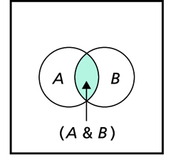
Probabilistic and Statistical Techniques
Probabilistic and Statistical Techniques
Multiplication Rule
The rule for finding P(A and B) is called the multiplication rule.

Slide 4
Probabilistic and Statistical Techniques
Tree Diagrams
A tree diagram is a picture of the possible outcomes of a procedure, shown as line segments emanating from one starting point. These diagrams are helpful if the number of possibilities is not too large.

Slide 5
Probabilistic and Statistical Techniques
Tree Diagrams
Lets assume that the first question on a test is a true/false type, while the second question is a multiple choice type with five possible answers (a, b, c, d, e)

Slide 6
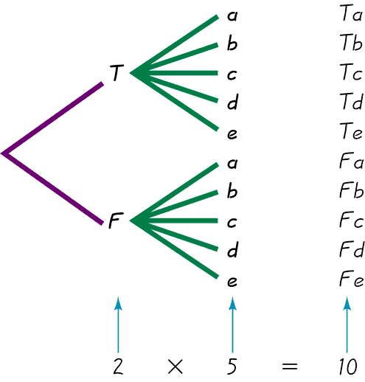
Probabilistic and Statistical Techniques
Tree Diagrams
This figure summarizes
the possible outcomes
for a true/false followed
by a multiple choice question.
Note that there are 10 possible combinations.

Slide 7
Probabilistic and Statistical Techniques
Tree Diagrams
Assume that: The answers to the two questions are True and C
Find the probability that if someone makes random guesses for both answers, the first answer will be correct and the second answer will be correct

Slide 8
Probabilistic and Statistical Techniques
Tree Diagrams
If the answers are random guesses, then the 10 possible outcomes are equally likely, so
Now note that P(T and c)=1/10, P(T)=1/2, P(C)=1/5…From which we see that:

Slide 9
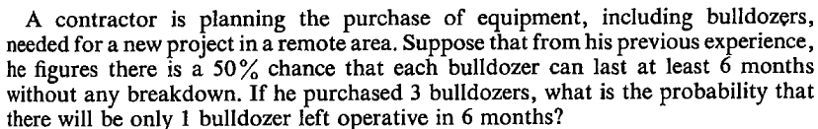

Example

Slide 10
Solution
Events: GGG, GGB, GBB, BBB, BBG, BGG, BGB,GBG
Events GGG =1/2*1/2*1/2=1/8
Total number of events = 8
Events GGB =1/2*1/2*1/2=1/8

Slide 11
Probabilistic and Statistical Techniques
Tree Diagrams
Our First example of the True/False and multiple choice questions suggested that
P(A and B) = P(A)*P(B)
But the next example will introduce another important element.

Slide 12
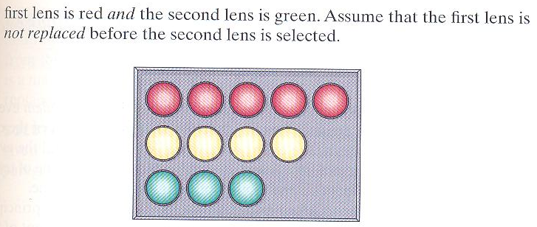
Probabilistic and Statistical Techniques
Example 1
Traffic Signal
A box contains glass lenses used for traffic signal. 5 of the lenses are red, 4 are yellow and 3 are green. If 2 of the lenses are randomly selected.
Find the probability that:
First is red and the second is green,
Assume no replacement

Slide 13
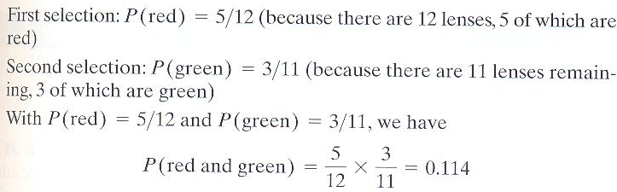
Probabilistic and Statistical Techniques
Example 1

Slide 14
Probabilistic and Statistical Techniques
Key Point – Conditional Probability
This example illustrates the important principle that: the probability for the second event B should take into account the fact that the first event A has already occurred.

Slide 15
Notation for Conditional Probability
Probabilistic and Statistical Techniques
represents the probability of event B occurring after it is assumed that event A has already occurred ( read B /A as “B given A.”)

Slide 16
Definitions
Probabilistic and Statistical Techniques
Independent Events
For example , Flipping a coin and then tossing a die are independent events because the outcomes of the coin has no effect on the probabilities of the outcomes of the die.
Two events A and B are independent if the occurrence of one does not affect the probability of the occurrence of the other.
If A and B are not independent, they are said to be dependent.
Notes:
Page 162 of Elementary Statistics, 10th Edition

Slide 17
Formal Multiplication Rule
Probabilistic and Statistical Techniques
Note that if A and B are independent events,

Slide 18
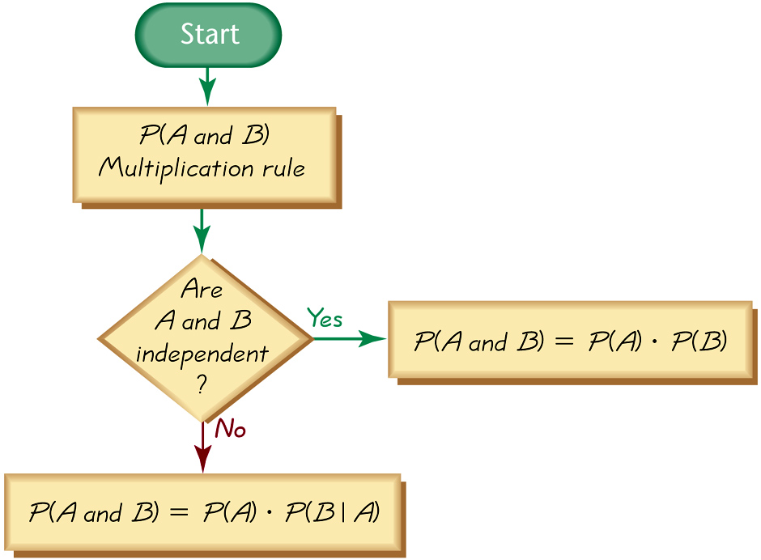
Probabilistic and Statistical Techniques
Applying the
Multiplication Rule

Slide 19
Probabilistic and Statistical Techniques
Example 2
Jury selection
A pool of jurors consists of 10 men and 15 women, two names are selected randomly
Find the probability that the first is a man and the second is a man
With replacement
Without replacement
Solution
a) With replacement …the two selections are independent
b) Without replacement…. the two selections are dependent

Slide 20
Complements: The Probability of “At Least One”
Probabilistic and Statistical Techniques
“At least one” is equivalent to “one or more.”
The complement of getting at least one item of a particular type is that you get no items of that type.

Slide 21
Probabilistic and Statistical Techniques
Key Principle
To find the probability of at least one of something, calculate the probability of none, then subtract that result from 1. That is,
P( at least one) = 1 – P( none).

Slide 22
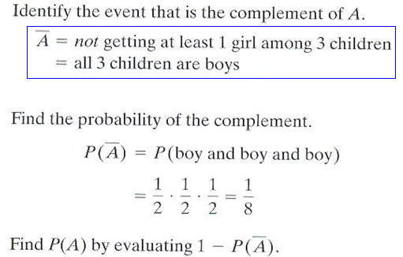

Probabilistic and Statistical Techniques
Example 3
Gender of Children
Find the probability that a couple with 3 children having at least 1 girl .
Solution

Slide 23
Example 4
Probabilistic and Statistical Techniques
Probabilistic and Statistical Techniques
Probabilistic and Statistical Techniques
If a die is rolled 4 times, find the probability that at least one of the rolls is a six.
If E is the event that at least one roll is a six, then E’ is the event that none of the four rolls is a six. Since all rolls are independent, the probability of four rolls all being not six is:
And so the probability of at least one six occurring is:

Slide 24
Probabilistic and Statistical Techniques
Definition
A conditional probability of an event is a probability obtained with the additional information that some other event has already occurred.

Slide 25
Probabilistic and Statistical Techniques
Conditional Probability Using Venn Diagram
A
B
B
S
Event (A ∩ B)

Slide 26
Probabilistic and Statistical Techniques
Example 5
Suppose a passenger on the Titanic is chosen at random,
let
M be the event that they are a man,
W the event they are a woman, and
S that they survived
D that they died
Calculate:
 | Men | Women | Boys | Girls | Total
Survived | 332 | 318 | 29 | 27 | 706
Died | 1360 | 104 | 35 | 18 | 1517
Total | 1692 | 422 | 64 | 45 | 2223

Slide 27
Probabilistic and Statistical Techniques
Solution
 | Men | Women | Boys | Girls | Total
Survived | 332 | 318 | 29 | 27 | 706
Died | 1360 | 104 | 35 | 18 | 1517
Total | 1692 | 422 | 64 | 45 | 2223

Slide 28
Police Officer Promotions :Counts
Probabilistic and Statistical Techniques
Example 6
Men Women Total
Promoted 288 36 324
Not-Promoted 672 204 876
Total 960 240 1200

Slide 29
Police Officer Promotions: Fractions
Probabilistic and Statistical Techniques
Men Women Total
Promoted .24 .03 .27
Not-Promoted .56 .17 .73
Total .80 .20 1.00
P (man) = .80
P (woman) = .20
P (promoted) = .27

Slide 30
Police Officer Promotions
Probabilistic and Statistical Techniques
P (promoted |man) = P (promotion ∩ man)/ P(man) = 0.24/0.80 = 0.30
P (promoted |woman) = P(promoted∩woman)/P(woman) = 0.03/0.20 = 0.15

Slide 31
Sample Space “S” = Men & Women Promoted
Probabilistic and Statistical Techniques
0.56
0.24
0.03
.24
0.17
.03
Men Promoted Women

Slide 32
140 customers of a club
Probabilistic and Statistical Techniques
Example 7
Signal Married Total
Under 30 77 14 91
30 or over 28 21 49
Total 105 35 140

Slide 33
140 customers of a club
Probabilistic and Statistical Techniques
What is the probability of finding a customer who is single and under the age of 30?
If a customer is under 30,what is the probability that he or she is single?

Slide 34
140 customers of a club
Probabilistic and Statistical Techniques
Event A = single customer
Event B = married customer
Event C = under 30 customer
Event D = 30 or over
P(A&C) = 77 / 144
P(A/C) = P(A&C) = 77 / 91
P(C)

Slide 35
Probabilistic and Statistical Techniques
Example 8
The following table contains data from a study of two airlines fly to Small Town, USA.
 | Number of on time flights | Number of late flights | Sum
Airlines 1 | 33 | 6 | 39
Airlines 2 | 43 | 5 | 48
 | 76 | 11 | 87
If one of the 87 flights is randomly selected. Find the probability that the flight selected arrived on time given that it was an Airlines 2 flight.
Notes:
35

